Slide 1
Act Communicate Transcend – ACT 2020-1-HR01-KA227-SCH-094792
MANUAL
FOR E-LEARNING PLATFORM
&
RESOURCES
Act Communicate & Transcend (esldramaactivities.eu)
e-Learning Platform (esldramaactivities.eu)
Resources for elementary school teachers (esldramaactivities.eu)
Resources for secondary school teachers (esldramaactivities.eu)

Slide 2
MANUAL
e-Learning Platform (esldramaactivities.eu)
ACT – Act Communicate & Transcend is a project that is in complete harmony with the European Council’s recommendation on a comprehensive approach to teaching and learning of languages issued in 2018 which states that «multilingual competence is at the heart of the vision of a European Education Area.» It answers Erasmus+ call to support art, cultural and education sectors in addressing challenges caused by COVID-19.

Slide 3
MANUAL
e-Learning Platform (esldramaactivities.eu)
The latest surveys on accomplishments of English language learners as well as a comparative analysis of languages in education and training across the EU have revealed that “most Member States face challenges in ensuring appropriate learning outcomes in the field of languages” as stated in the EU official document. This clearly indicates the necessity to bring a change into the curricula and provide an innovative tool that will be directed at improving English language speaking skills.

Slide 4
MANUAL
e-Learning Platform (esldramaactivities.eu)
We believe that bringing drama-based activities into the classrooms across Europe will increase the level of students’ motivation, interest, engagement, and most importantly, facilitate their learning process as well as improve their speaking skills.
We have brought together 8 partners from 6 different countries and employed 12 ESL teachers to bring this project to life and carry it out for 24 months. Our multicultural and diverse cross-sectoral cooperation includes a theatre company, a directorate, a university, two NGOs, an adult education center, and a foreign language school.

Slide 5
MANUAL
e-Learning Platform (esldramaactivities.eu)
The aims of our project are
to assist the progress of learning English as a foreign language, in particular speaking skills, by developing a speaking assessment rubric, a set of training materials, a drama-based activity book, and, finally, an e-learning platform which will unite all previously mentioned intellectual outputs and be made available for use both for teachers and their students even after the project is finalized,
to develop new and innovative teaching methods and implement these directly into practice as well as professional development through project work.

Slide 6
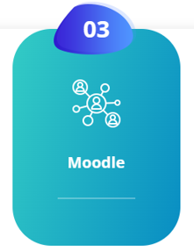
MANUAL
e-Learning Platform (esldramaactivities.eu)
In order to enter to the platform, first you click for
the project website
www.esldramaactivities.eu

Slide 7
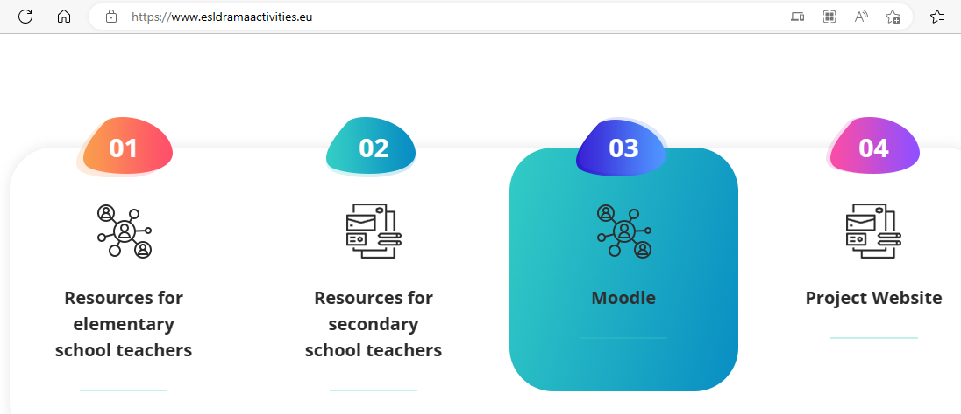
MANUAL
e-Learning Platform (esldramaactivities.eu)

Slide 8
MANUAL
e-Learning Platform (esldramaactivities.eu)
When you see the homepage as shown before, click «Moodle» section and then you will be able to sign up & login the Moodle platform
e-Learning Platform (esldramaactivities.eu)

Slide 9
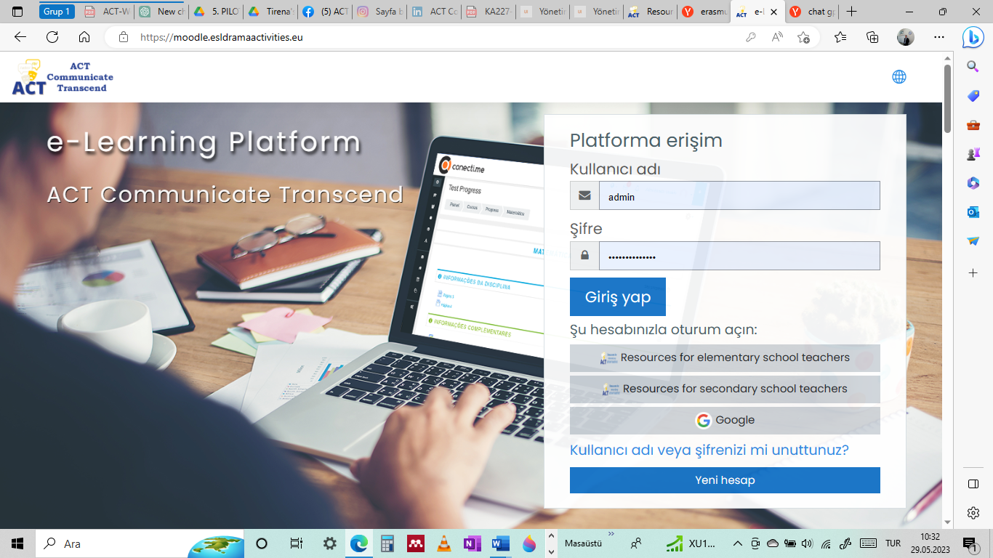
MANUAL
e-Learning Platform (esldramaactivities.eu)

Slide 10
MANUAL
e-Learning Platform (esldramaactivities.eu)
REMINDER!!! Please keep in mind that you will first need to register either to
Resources for elemantary schools teachers
or to
Resources for Secondary schools teachers in order to register to the Moodle platform before entering it

Slide 11
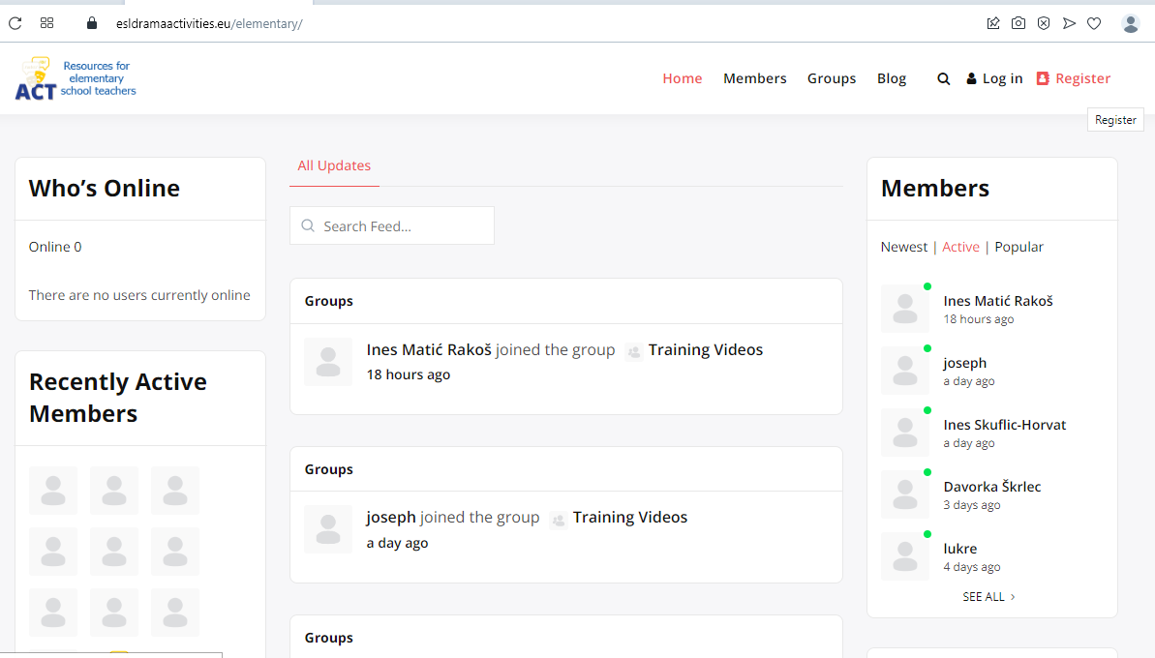
MANUAL
e-Learning Platform (esldramaactivities.eu)

Slide 12
MANUAL
e-Learning Platform (esldramaactivities.eu)
After registration process for either
‘Resources for elementary schools teachers’
or
‘Resources for secondary schools teachers’
you click the Moodle platform

Slide 13
MANUAL
e-Learning Platform (esldramaactivities.eu)
PLEASE NOTE THAT!!! The user must first be a member of the resources for elementary schools teachers or resources for secondary schools teachers platforms (except Moodle) as mentioned above.
As in the screenshot below, when you want to register and login to the Moodle platform from an account that you registered before, you have to click Single Sign On.
You should enter the member information in the other account and login. Then you will be registered to the platform.
For example, if the user is a member of the resources for elementary/secondary school teachers platform, the user can log in the Moodle.

Slide 14
MANUAL
e-Learning Platform (esldramaactivities.eu)

Slide 15
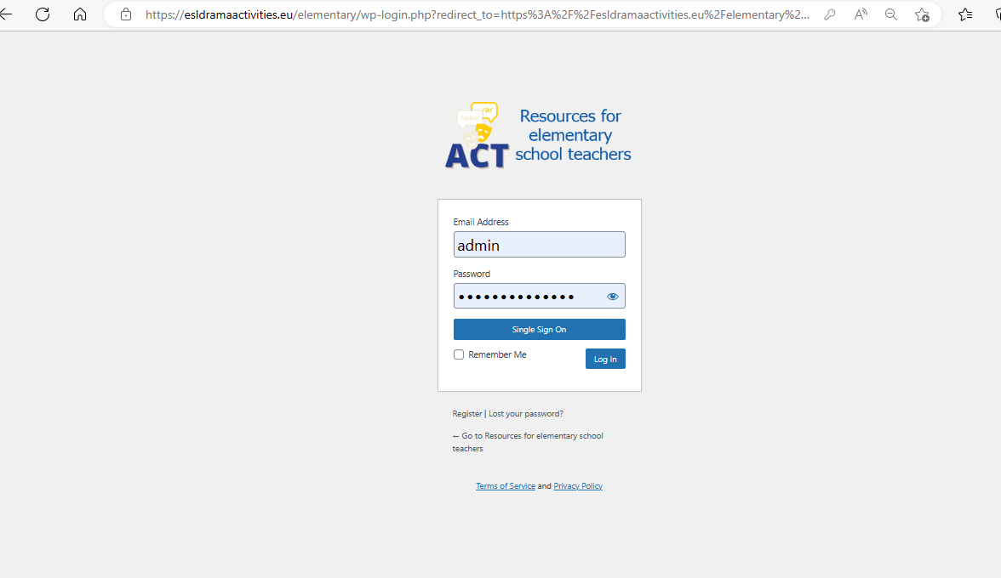
MANUAL
e-Learning Platform (esldramaactivities.eu)

Slide 16
MANUAL
e-Learning Platform (esldramaactivities.eu)
The e-learning platform consists of two modules as courses under the main titles of
Intro to the world of drama and drama-based curricula
and Training module: how to do

Slide 17
MANUAL
e-Learning Platform (esldramaactivities.eu)
GENERAL INFORMATION ABOUT EACH MODULE
MODULE 1: Intro to the world of drama and drama-based curricula
This course is intended to provide information about drama methods to improve speaking skills of ELT teachers in both elementary and secondary level schools.

Slide 18
MANUAL
e-Learning Platform (esldramaactivities.eu)
Acquirements at the end of the course:
At the end of the course the teachers will gain in-dept knowledge of drama-based speaking activities, improve their pedagogical skills, develop their language and cultural understanding as well as make their teaching more fun.
a deeper understanding of drama and its benefits in the classroom
understand the skills about how to use unique drama-based speaking assessment rubric
knowledge regarding how to use e-learning platform
quip teachers with drama skills to integrate them into improving the speaking skills of their students via using drama-based speaking curriculum, learning activities, training materials including an authentic rubric.

Slide 19
MANUAL
e-Learning Platform (esldramaactivities.eu)
Acquirements at the end of the course:
develop both teachers and students' identity, imagination and creative via applying drama-based activities and make them always different, new and innovative
gain knowledge, skills on the theoretical framework of drama education and tools in the form of drama techniques, methods that teachers, professors could use in their educational work
Teachers will be able to create their own drama-based speaking learning activities
Teachers will be equipped with the skills to support teaching by using types of drama (i.e., miming, short play, role-plays improvisation, script).

Slide 20
MANUAL
e-Learning Platform (esldramaactivities.eu)
Acquirements at the end of the course:
Teaches will gain skills to develop their students' speaking skills and decrease their anxiety levels, increase their self-confidence and enjoyment by utilizing drama-based speaking activities
Teachers will have an understanding of gaining innovative skills to improve speaking skills in teaching English as a foreign language and intercultural skills, EU citizenship and values.

Slide 21
MANUAL
e-Learning Platform (esldramaactivities.eu)
GENERAL INFORMATION ABOUT EACH MODULE
MODULE 2: Training module: how to do
This course is intended to train the English language teachers in primary and secondary schools about how to design, implement, assess and use drama-based speaking activities.

Slide 22
MANUAL
e-Learning Platform (esldramaactivities.eu)
Acquirements at the end of the course:
By being able to create drama-based speaking activities ELT teachers will be able to use them in their classes and contribute more efficiently to the development of their students' speaking skills.
Teacher will gain skills, knowledge about how to create an innovative curricula including drama-based speaking activities and will enrich their professional skills in developing speaking skills of their students
Teachers will be fully aware of the benefits of drama-based activities
Teachers will be able to assess and gain insights about their learners' knowledge, attitudes, and behaviour with respect to the target language

Slide 23
MANUAL
e-Learning Platform (esldramaactivities.eu)
Acquirements at the end of the course:
give teachers an effective methodical tool of how to educate learners for improving speaking skills via drama
equip teachers with drama skills in teaching English as a foreign language to create their own drama-based learning activities
teachers will be able to adapt drama activities into the teachings for improving the speaking skill
Language teachers will be able to design and apply theme-based future drama-based speaking curricula and learning activities that can also be used as a supplementary tool.
Language teachers will be able to develop and design level and age-appropriate drama-based speaking activities

Slide 24
MANUAL
e-Learning Platform (esldramaactivities.eu)
Acquirements at the end of the course:
Using songs, chants, rhymes, exploring mimics in their drama-based speaking activities, teachers will have the chance to understand how to assess:
vocabulary acquisition
pronunciation
reading and understanding
listening
Teachers will understand gaining innovative skills to improve speaking skills in teaching English as a foreign language and intercultural skills, EU citizenship and values.

Slide 25
MANUAL
e-Learning Platform (esldramaactivities.eu)
When you enter the Moodle platform click ‘Site Home’
you will encounter with the available courses as shown below

Slide 26
MANUAL
e-Learning Platform (esldramaactivities.eu)

Slide 27
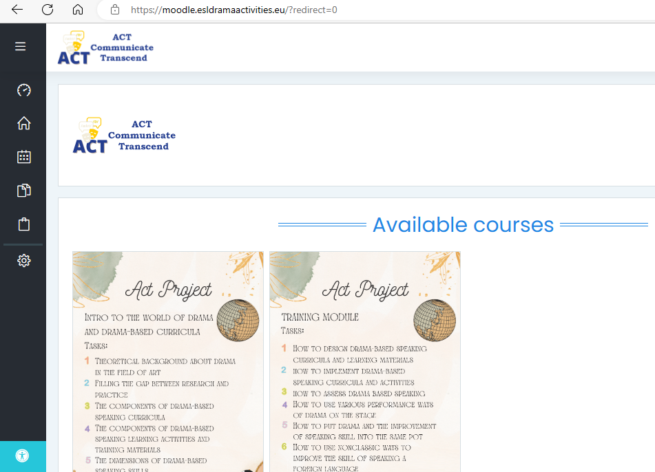
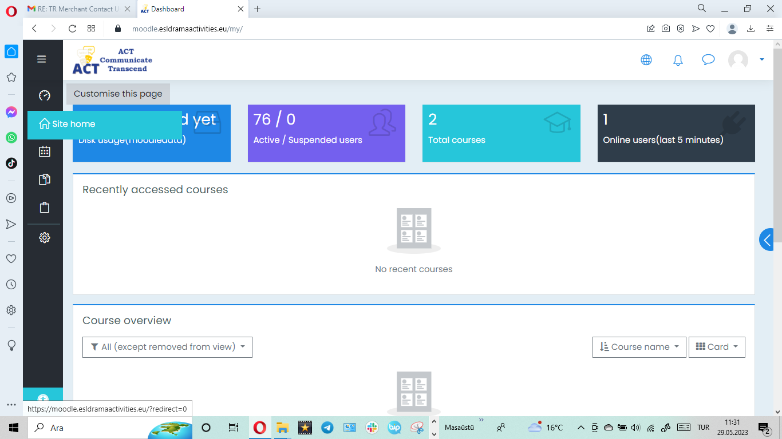
MANUAL
e-Learning Platform (esldramaactivities.eu)

Slide 28
MANUAL
e-Learning Platform (esldramaactivities.eu)

Slide 29
MANUAL
www.esldramaactivities.eu
Within each module there are sub-headings as shown below.
After finishing the course in each title, 3 questions will be encountered. These questions are intended to reinforce the subject.

Slide 30
MANUAL
MODULE-1: Intro to the world of drama and drama-based curricula
www.esldramaactivities.eu
Sub-heading-1:
Theoretical background about drama in the field of art, speaking
Question 1
Question 2
Question 3

Slide 31
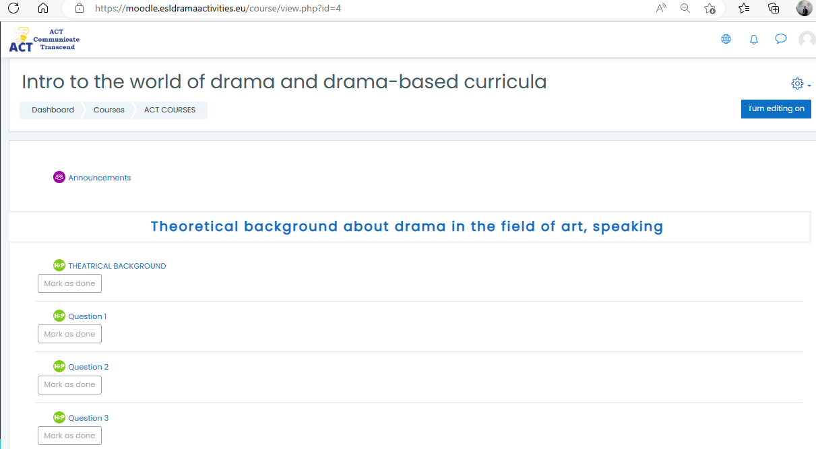
MANUAL
www.esldramaactivities.eu

Slide 32
MANUAL
MODULE-1: Intro to the world of drama and drama-based curricula
www.esldramaactivities.eu
Sub-heading-2:
The summary of research (Filling the gap between research and practice)
Question 1
Question 2
Question 3

Slide 33
MANUAL
www.esldramaactivities.eu

Slide 34
MANUAL
MODULE-1: Intro to the world of drama and drama-based curricula
www.esldramaactivities.eu
Sub-heading-3:
The components of drama-based speaking curricula
Question 1
Question 2
Question 3

Slide 35
MANUAL
www.esldramaactivities.eu

Slide 36
MANUAL
MODULE-1: Intro to the world of drama and drama-based curricula
www.esldramaactivities.eu
Sub-heading-4:
The components of drama-based speaking learning activities and training materials
Question 1
Question 2
Question 3

Slide 37
MANUAL
www.esldramaactivities.eu

Slide 38
MANUAL
MODULE-1: Intro to the world of drama and drama-based curricula
www.esldramaactivities.eu
Sub-heading-5:
The dimensions of drama-based speaking skills
Question 1
Question 2
Question 3

Slide 39
MANUAL
www.esldramaactivities.eu

Slide 40
MANUAL
MODULE-1: Training module: how to do
www.esldramaactivities.eu
Sub-heading-1:
How to design drama-based speaking curricula and learning materials
Question 1
Question 2
Question 3

Slide 41
MANUAL
www.esldramaactivities.eu

Slide 42
MANUAL
MODULE-1: Training module: how to do
www.esldramaactivities.eu
Sub-heading-2:
How to implement drama-based speaking curricula and learning activities
Question 1
Question 2
Question 3

Slide 43
MANUAL
www.esldramaactivities.eu

Slide 44
MANUAL
MODULE-1: Training module: how to do
www.esldramaactivities.eu
Sub-heading-3:
How to assess drama based speaking (cognitive, affective, linguistic (pronunciation, grammar, vocabulary))
Question 1
Question 2
Question 3

Slide 45
MANUAL
www.esldramaactivities.eu

Slide 46
MANUAL
MODULE-1: Training module: how to do
www.esldramaactivities.eu
Sub-heading-4:
How to use various performance ways of drama on stage
Question 1
Question 2
Question 3

Slide 47
MANUAL
www.esldramaactivities.eu

Slide 48
MANUAL
MODULE-1: Training module: how to do
www.esldramaactivities.eu
Sub-heading-5:
How to put drama and the improvement of speaking skill into the same pot
Question 1
Question 2
Question 3

Slide 49
MANUAL
www.esldramaactivities.eu

Slide 50
MANUAL
MODULE-1: Training module: how to do
www.esldramaactivities.eu
Sub-heading-6:
How to use nonclassic ways to improve the skills of speaking a foreign language
Question 1
Question 2
Question 3

Slide 51
MANUAL
www.esldramaactivities.eu

Slide 52
MANUAL
MODULE-1: Training module: how to do
www.esldramaactivities.eu
Sub-heading-7:
How to present the use of drama activities on the platform in the most interactive way to improve the speaking skill
Question 1
Question 2
Question 3

Slide 53
MANUAL
www.esldramaactivities.eu

Slide 54
MANUAL
MODULE-1: Training module: how to do
www.esldramaactivities.eu
Sub-heading-8:
How to get self-confidence in speaking rather than being scared of making mistakes
Question 1
Question 2
Question 3

Slide 55
MANUAL
www.esldramaactivities.eu

Slide 56
MANUAL
MODULE-1: Training module: how to do
www.esldramaactivities.eu
Sub-heading-9:
How to do a confidential speech in the foreign language/English
Question 1
Question 2
Question 3

Slide 57
MANUAL
www.esldramaactivities.eu

Slide 58
MANUAL
MODULE-1: Training module: how to do
www.esldramaactivities.eu
Sub-heading-10:
How to be accepted in a foreign society with your speaking in which all the communication is in English
Question 1
Question 2
Question 3

Slide 59
MANUAL
www.esldramaactivities.eu

Slide 60
MANUAL
www.esldramaactivities.eu
This publication [communication] reflects the views only of the author, and the Commission cannot be held responsible for any use which may be made of the information contained therein.

